Slide 1

HOUSING MARKET DATA ANALYSIS Lavanya Telapudi

Slide 2
Introduction
The aim of this project is to give information about the Housing details to the customers and how house prices have risen at record levels in recent months, hitting the peak increase of 19.3 percent in July 2021 in the wake of the short but steep COVID-19 recession.
Ability to set up property information such as, this data from Redfin summarize the monthly housing market for every State, Metro, and Zip code in the US from 2012 to 2021.
It includes property type, like whether it is a Residential or Townhouse or Single-family home or a Cooperative.
Home sales, Average sale to list, Inventory, Median active list price, Median sale price, Pending home sales, Total homes sold with price drops are also included in the property information
The key focus is given to the new residential market statistics for new construction homes. Included building permit data provided by the Census—allowing users to analyze average construction costs and compare the number of units built per capita across regions.

Slide 3
Purpose of Data Analysis:
which type of Property are customers interested to buy over the years?
Total number of homes that were sold in each state or metro station during a given time period.
How real-estate got affected due to Covid-19
Despite the large drops in home sales due to the pandemic, real estate activity began to improve in the late spring, approaching pre-pandemic levels by the summer. Potential buyers started to increase their housing search and purchase activity by the end of May.
Americans, many now used to work remotely, began buying farther away from some cities and traditional job centers and that is why sales increased relatively from 2019 to 2021

Slide 4
This dataset from Redfin tells us about the inventory where it is total number of active listings on the last day of a given time period.
Median days on market: The number of days between the date the home was listed for sale and when the home went off-market/pending sale covering all homes.
It also gives us the info about the Median list price per square foot and Median sale price per square foot.
Total homes sold with price drops :The total number of homes with a sale date during a given time period and where the sale price is less than the latest listing price.

Slide 5
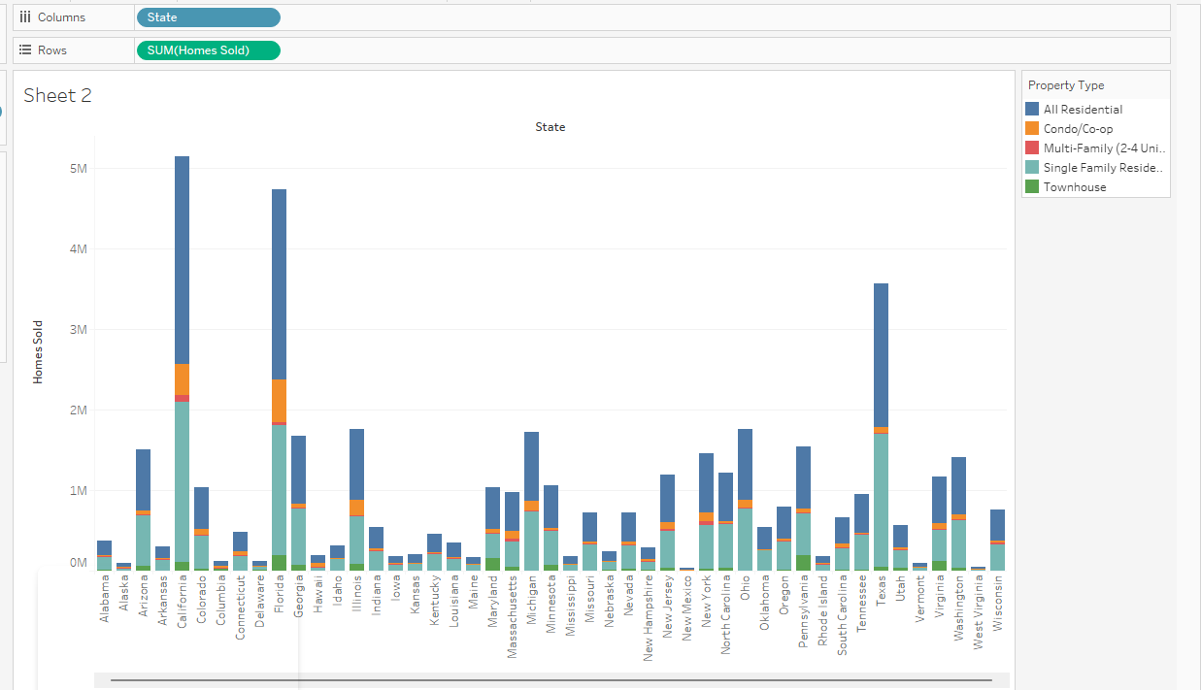
Visualizations From Tableau
1

Slide 6
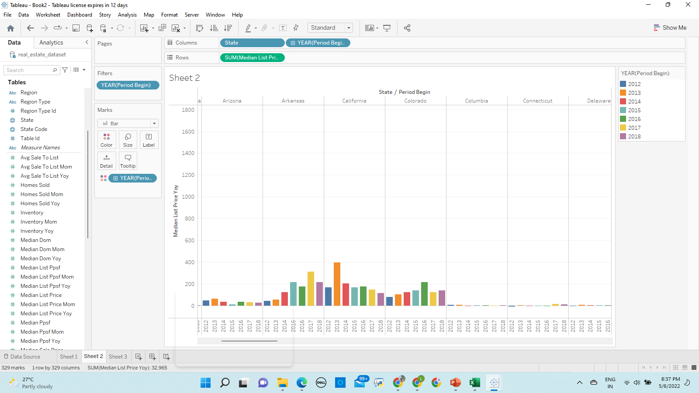
2

Slide 7
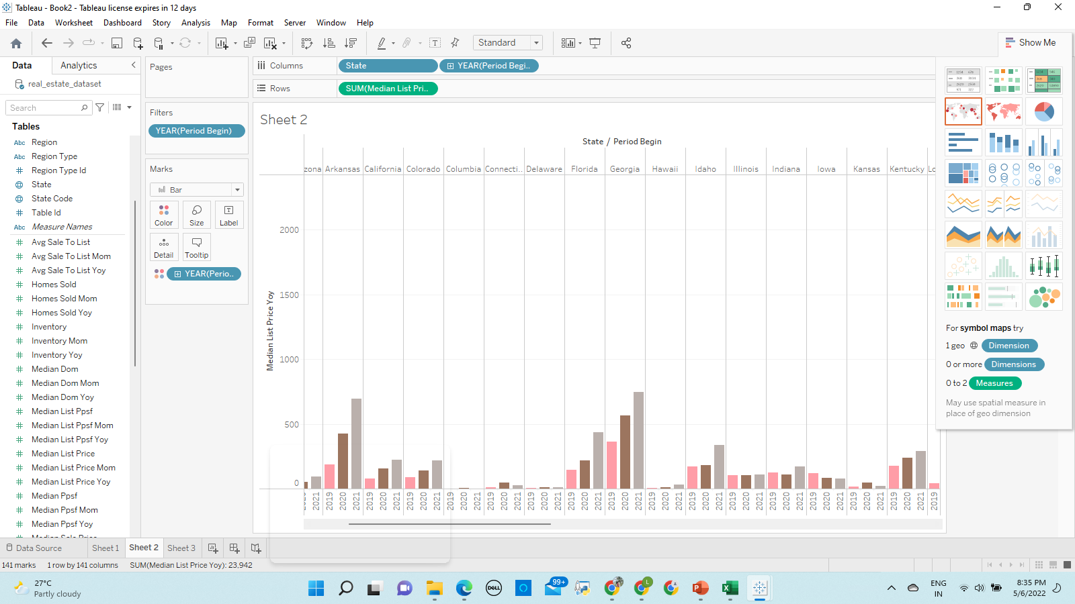
Homes are 34% more expensive. Buyers are twice as likely to pay above list price as they grapple with fierce competition.

Slide 8
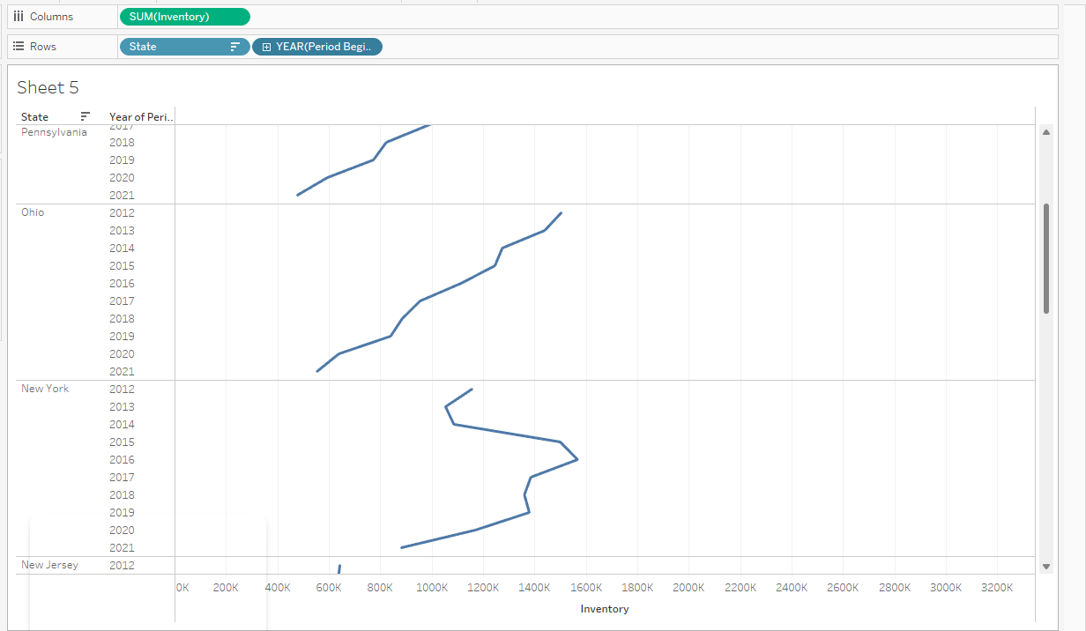
3

Slide 9
New listings, despite improving from their April lows, were only slightly higher than one year ago through August. As a result, inventory continued to decline: In August 2020, there were less than two-thirds the number of homes on the market as there were in August 2019. While health-related concerns may continue to keep sellers from the market, surveys indicate that the overall economic uncertainty and the inability to purchase another home are also keeping homeowners in place.

Slide 10
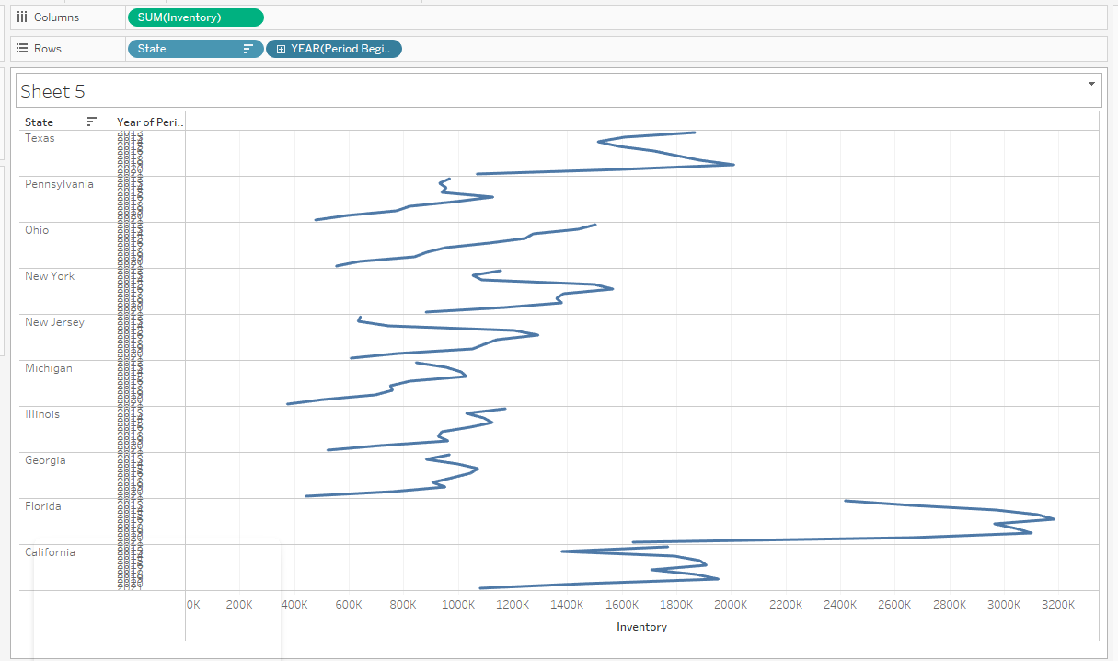

Slide 11
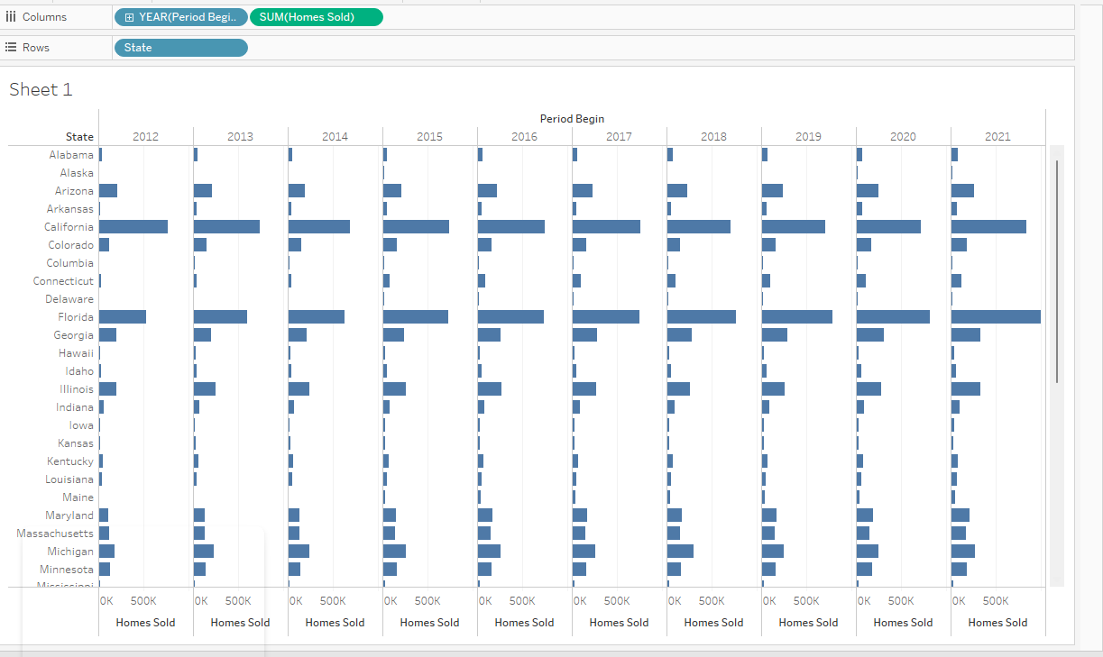
4

Slide 12
Target Users
This system will be used by multiple people with different roles and responsibilities:
Property Manager
Listing Agent
Possible Tenant
Possible Buyer
Tenant
Researcher etc

Slide 13
Modules
Homes sold
Lease
Sale
Services
Billing/payment
Application Security

Slide 14
Features
Maintain client and property details
Amenities details
Floor plans
Tenant & lease tracking
Applicant tracking
Contact with Renters
Vacancy postings
Maintenance requests and cycle management
Reporting dashboard
Accounting tools
Document management

Slide 15

Property
Property is driving factor for all other modules. Property is the strong entity and remaining all are one or other way dependent on it.
Property can be:
Building
Complex
Floor
Unit
Land
All types of properties will be maintained in single table and relationship will be maintained separately.

Slide 16
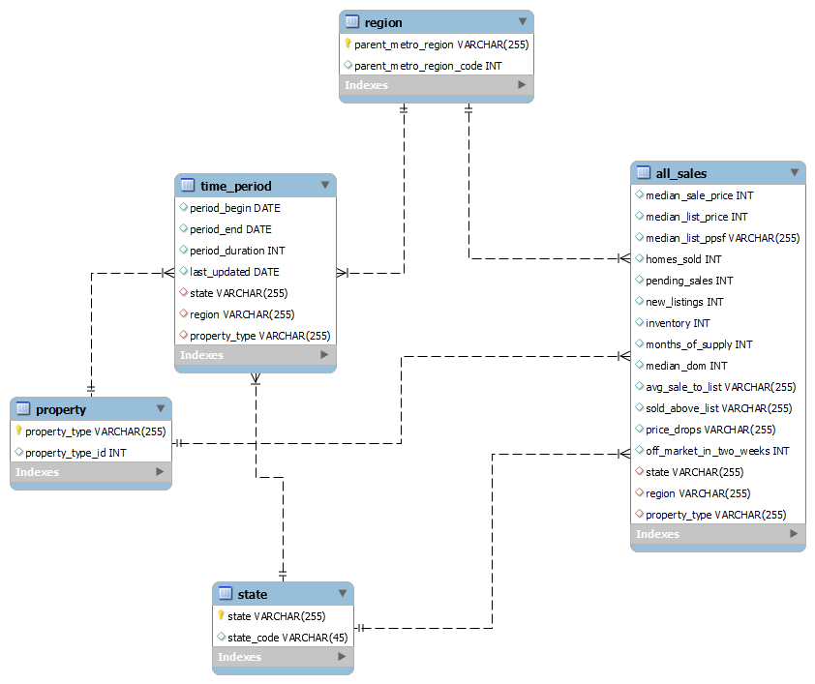
ER Diagram

Slide 17
AWS PRICING CALCULATOR | Per month
AWS S3 | 1150 $
RDS | 404.02 $
Amazon Glue | 1.41 $

Slide 18
QUERIES??

Slide 19
THANK YOU...

